Slide 1
Integrating LLMs into Barilla
Project
Juri Fabbri | Data Scientist

Slide 2
Outline
Barilla Project Workflow
Understanding Large Language Models (LLMs)
LLMs Limitations
LMMs Introduction
LMMs applications
GPT-4 Vision
Application Demo

Slide 3
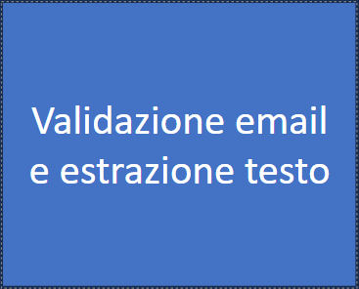
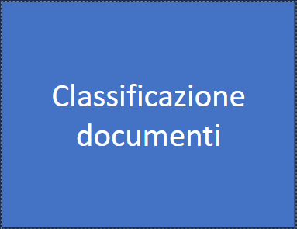
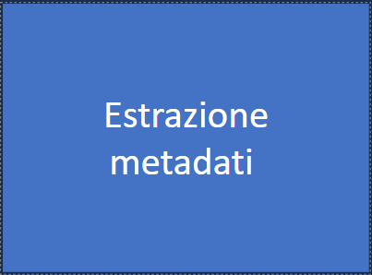
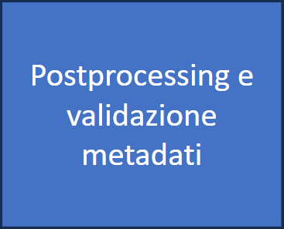
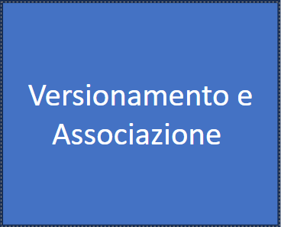
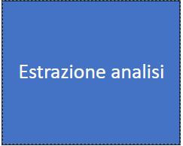
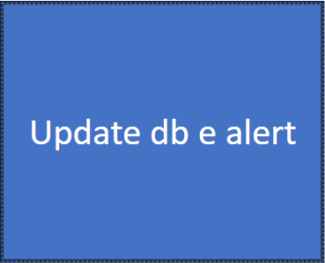

Barilla Project Workflow
We can have potential improvements with LLMs

Slide 4
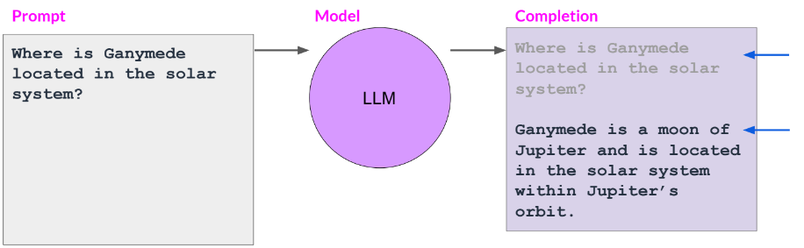
Understanding Large Language Models (LLMs)
“A large language model (LLM) is a type of language model notable for its ability to achieve general-purpose language understanding and generation.”
(Wikipedia)
Input: Prompt
Output: Completion
LLM applications: Writing, Reading, Chatting

Slide 5
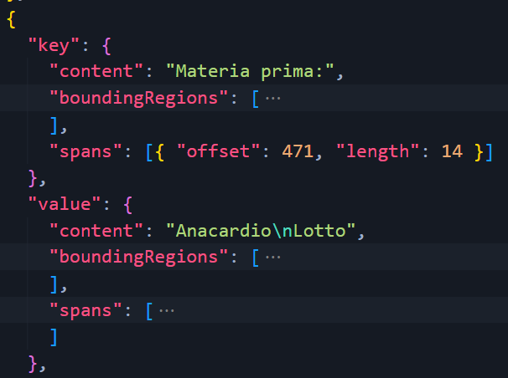
LLMs Limitations
By default an LLM has lots of limitation, in our case the issue is:
We need to extract text from the files we receive to give it as input to the LLM
Often the mentioned text is not extracted correctly from “standard” OCRs as Form Recognizer
This implies results we can achieve using LLMs are bottlenecked from the OCR performances.
How to overcome this?
This shouldn’t be here !

Slide 6

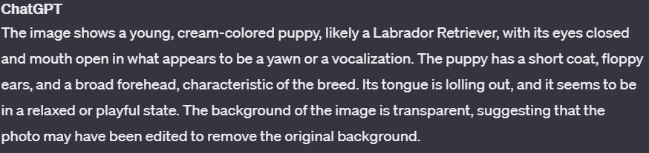
LMMs Introduction
“A large multimodal model (LLM) is a more advanced form of AI model, capable of processing multiple types of data inputs.”
Input: Image, Text, Audio
Output: Text Completion
Task: Describe the above picture
LMM applications: Same as before and much more!

Slide 7
LMMs applications
Thanks to the end-to-end approach we can adopt with a LMM, we can extract metadata from a file without strictly relying on OCR results. Where is the improvement?
We can abstract from the language:
LMMs work with every language, bypassing source language whereas LLMs rely on OCR performance
The implementation is faster:
We just need to build the LMM calls infrastructure, without needing a framework to handle boxes…
Overall easier code to write and maintain.
Better performance:
Through sota computer-vision LMMs are able to look through the document as a whole also understanding the geometry of the page where the text is extracted from without having to “guess”, as we currently do.
LMMs are much better at recognizing and handling tables than all other commonly used OCRs

Slide 8
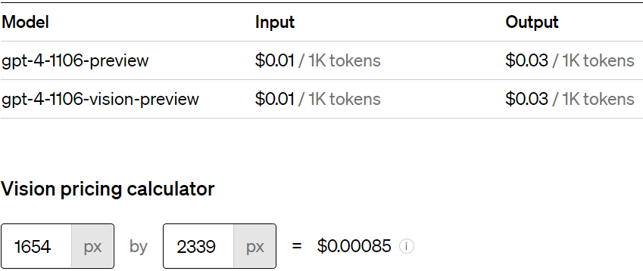
GPT-4 Vision by OpenAPI
PROS:
Current SOTA
Easy API
Integrated in many frameworks to be productionized (Eg: LangChain, Microsoft Semantic Kernel)
All in One: we can interact with a single model to develop all workflow steps
We could also make a further step including RAG and chat with input documents
CONS:
Closed source (Open source LMMs are still not performant enough to be considered yet)
Expensive: on average a call as the one shown in the demo in the next page costs about $0.50
We have to consider that with $0.50 we completely “solve” a document
The cost of previous versions dropped by 10x in a year and by 40x in 3 years!

Slide 9
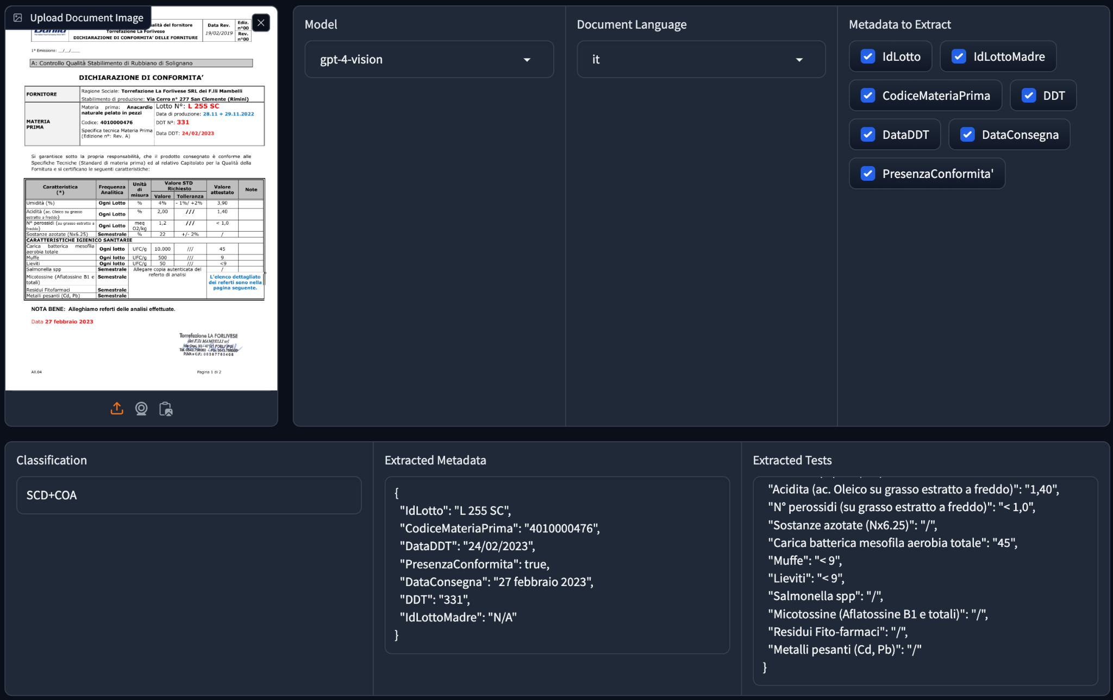
Application Demo
Link to the demo

Slide 10
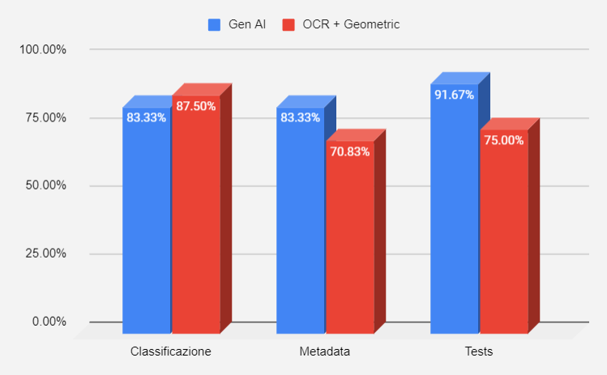
GPT4 vs Current State
I run a benchmark with an “hard” dataset, consisting mostly of documents where we currently have issues with the current model.
Metadata extraction and tests extractions are excellent, especially considering that regarding tests, the new model includes the value of the extracted test and not just the test presence.
We see a little regression in classification, signaling our algorithm is already performing well in that area without the need of extra effort but rather a fine tuning.
It is significant to point out that no “ad hoc” plant-domain configurations were used for GPT4 during the benchmark potentially biasing the results towards Geometric model.

Slide 11


Thanks!

